Slide 1
Yadagiri Likhitha
Final Project
3/21/2024 Annual Review

Slide 2
PROJECT TITLE
Keylogger
&
Security
3/21/2024 Annual Review

Slide 3


AGENDA
This presentation provides an insight into Enhancing Security
Measures through the use of a Keylogger Python Program.
The program's functionalities and potential impact on security
will be discussed.
3/21/2024 Annual Review

Slide 4

PROBLEM STATEMENT
Keyloggers are a genuine danger to clients and the clients'
information, which is considered exploitative movement.
The problem statement is that the keyloggers can be
detected using antiviruses. Installation of hardware
keyloggers is difficult without the knowledge of the owner of the system.
3/21/2024 Annual Review

Slide 5

PROJECT OVERVIEW
Introduction:
Briefly introduce the project and its significance in the context of cybersecurity.
Highlight the growing threat of keyloggers and the need for effective countermeasures.
Project Objectives:
Developing a better understanding of keylogger functionality and behavior.
Evaluating the effectiveness of existing detection and prevention methods.
Proposing improvements or new approaches to mitigate keylogger risks.
Resources Required:
Identify the resources needed to carry out the project successfully.
This may include personnel, equipment, software tools, and access to research materials.
Conclusion:
Summarize the key points covered in the project overview.
Reiterate the importance of the project in addressing keylogger threats and enhancing cybersecurity resilience.
3/21/2024 Annual Review

Slide 6

WHO ARE THE END USERS?
Security Professionals: Security professionals might use keyloggers for ethical hacking, penetration testing, or security auditing purposes to identify vulnerabilities in systems and networks.
Employers: Some employers may use keyloggers to monitor employees' computer activities for security, productivity, or compliance reasons, especially in industries where sensitive information is handled.
Individuals: Individuals might use keyloggers to monitor their own computer usage, track their typing speed, or keep a record of their keystrokes for personal reasons.
Law Enforcement: Law enforcement agencies might use keyloggers as part of their investigations into cybercrime, such as hacking, identity theft, or fraud.
3/21/2024 Annual Review

Slide 7

YOUR SOLUTION AND ITS VALUE PROPOSITION
Prevention: - Educate users: Teach users about the risks
associated with keyloggers and how to recognize suspicious behavior.
Use antivirus and antimalware software: Invest in reputable security software that can detect and prevent keyloggers from being installed on your system.
Keep software updated: Regularly update your operating system and software to patch vulnerabilities thatcould be exploited by keyloggers.
The value proposition of a robust keylogger prevention and detection solution lies in safeguarding sensitive information, protecting privacy, and maintaining the integrity of systems and networks. By implementing effective security measures, businesses and individuals can mitigate the risks associated with keyloggers and other forms of malware.
3/21/2024 Annual Review

Slide 8

THE WOW IN YOUR SOLUTION
Advanced Threat Detection: Utilizing cutting-edge machine learning algorithms and behavioral analysis, the solution can detect even the most sophisticated keyloggers, including those designed to evade traditional antivirus software.
Real-time Monitoring and Response: Offering real-time monitoring of user activities across devices, the solution can swiftly identify and respond to suspicious behavior indicative of keylogger activity, minimizing the potential damage.
Privacy-Preserving Features: Implementing privacy-preserving features such as encrypted keystroke transmission and secure storage ensures that sensitive information remains protected even in the event of a
keylogger compromise.
User-Friendly Interface: Providing an intuitive user interface that empowers individuals and organizations to easily manage their security settings, monitor for threats, and take proactive measures to enhance their defenses against keyloggers.
3/21/2024 Annual Review

Slide 9
MODELLING
Teams cam add wireframes
Home Tab:
- Overview of the keylogger project, including project status, latest updates, and keymetrics.
- Quick links to essential project resources, such as documentation, FAQs, and support channels.
Tasks Tab:
- Kanban-style board for managing keylogger project tasks, with columns for To-Do, In Progress,
and Completed tasks.
- Ability to create new tasks, assign them to team members, set due dates, and track progress.
- Integration with Microsoft Planner or other task management tools for seamless task tracking.
Calendar Tab:
- Shared calendar view displaying key project milestones, deadlines, and meetings.
- Option to schedule new meetings, sync with Outlook calendar, and set reminders for important events.
3/21/2024 Annual Review

Slide 10
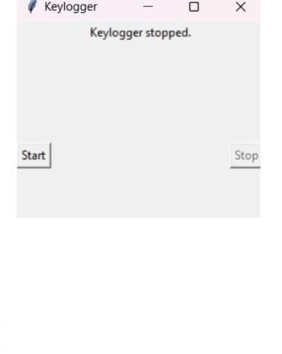

RESULTS
Key_log Json file:[{"Pressed": "'n'"}, {"Held": "'n'"}, {"Released": "'n'"}, {"Pressed": "'o'"}, {"Held": "'o'"}, {"Released": "'o'"}, {"Pressed": "Key.backspace"}, {"Held": "Key.backspace"}, {"Held": "Key.backspace"}, {"Held": "Key.backspace"}, {"Held": "Key.backspace"}]
Key Log Text file:
3/21/2024 Annual Review

Slide 11
Project Link:
https://github.com/Likhitha-yadagiri/project.git

Slide 12
THANKYOU

